Slide 1
Classes and Objects in Java
Basics of Classes in Java

Slide 2
Editor-notepad, IDE- classname.java
Compiler-jdk 1.8 or 1.9, javac- javac filename.java
Run- JVM- java filename

Slide 3
Hello.java
Class Hello{
Public static void main(Strings a[]){
Int n1=6;
Int n2;
Int result=n1+n2;
System.out.println(result);
}
}
d/

Slide 4
S.o.p(5+5);
Data types
Int, float, double, char, short int, long int, byte
Naming convention
  Variable name-
  Class name-
  Constant
  Interface name-

Slide 5
Class Add{
Int n1;
Int n2;
Int result;
Public void perform(){
Result=n1+n2;
}
}

Slide 6
Public class Calc{
Public static void main (Strings arg[]){
Add obj1=new Add();
Obj1.n1=8;
Obj1.n2=10;
Obj1.perfom();
S.o.p(obj1.result);
}}

Slide 7
Contents
Introduce to classes and objects in Java.
Understand how some of the OO concepts learnt so far are supported in Java.
Understand important features in Java classes.

Slide 8
Introduction
Java is a true OO language and therefore the underlying structure of all Java programs is classes.
Anything we wish to represent in Java must be encapsulated in a class that defines the “state” and “behaviour” of the basic program components known as objects.
Classes create objects and objects use methods to communicate between them. They provide a convenient method for packaging a group of logically related data items and functions that work on them.
A class essentially serves as a template for an object and behaves like a basic data type “int”. It is therefore important to understand how the fields and methods are defined in a class and how they are used to build a Java program that incorporates the basic OO concepts such as encapsulation, inheritance, and polymorphism.

Slide 9
Classes
A class is a collection of fields (data) and methods (procedure or function) that operate on that data.
Circle
centre
radius
circumference()
area()

Slide 10
Classes
A class is a collection of fields (data) and methods (procedure or function) that operate on that data.
The basic syntax for a class definition:
Bare bone class – no fields, no methods
  class ClassName [extends SuperClassName]
  {
    [fields declaration]
    [methods declaration]
}
public class Circle {
// my circle class
}

Slide 11
Adding Fields: Class Circle with fields
Add fields
The fields (data) are also called the instance varaibles.
public class Circle {
public double x, y; // centre coordinate
public double r; // radius of the circle
}

Slide 12
Adding Methods
A class with only data fields has no life. Objects created by such a class cannot respond to any messages.
Methods are declared inside the body of the class but immediately after the declaration of data fields.
The general form of a method declaration is:
type MethodName (parameter-list)
{
Method-body;
}

Slide 13
Adding Methods to Class Circle
public class Circle {
public double x, y; // centre of the circle
public double r; // radius of circle
//Methods to return circumference and area
public double circumference() {
return 2*3.14*r;
}
public double area() {
return 3.14 * r * r;
}
}
Method Body

Slide 14
Data Abstraction
Declare the Circle class, have created a new data type – Data Abstraction
Can define variables (objects) of that type:
    Circle aCircle;
    Circle bCircle;

Slide 15
Class of Circle cont.
aCircle, bCircle simply refers to a Circle object, not an object itself.
aCircle
bCircle
null
null
Points to nothing (Null Reference)
Points to nothing (Null Reference)

Slide 16
Creating objects of a class
Objects are created dynamically using the new keyword.
aCircle and bCircle refer to Circle objects
aCircle = new Circle() ;
bCircle = new Circle() ;

Slide 17
Creating objects of a class
aCircle = new Circle();
bCircle = new Circle() ;
bCircle = aCircle;

Slide 18
Creating objects of a class
aCircle = new Circle();
bCircle = new Circle() ;
bCircle = aCircle;
Before Assignment
Before Assignment
aCircle
bCircle
aCircle
bCircle
P
Q
P
Q

Slide 19
Automatic garbage collection
Q
The object does not have a reference and cannot be used in future.
The object becomes a candidate for automatic garbage collection.
Java automatically collects garbage periodically and releases the memory used to be used in the future.

Slide 20
Accessing Object/Circle Data
Similar to C syntax for accessing data defined in a structure.
ObjectName.VariableName
ObjectName.MethodName(parameter-list)
Circle aCircle = new Circle();
aCircle.x = 2.0 // initialize center and radius
aCircle.y = 2.0
aCircle.r = 1.0

Slide 21
Executing Methods in Object/Circle
Using Object Methods:
sent ‘message’ to aCircle
Circle aCircle = new Circle();
double area;
aCircle.r = 1.0;
area = aCircle.area();

Slide 22
Using Circle Class
// Circle.java: Contains both Circle class and its user class
//Add Circle class code here
class MyMain
{
public static void main(String args[])
{
Circle aCircle; // creating reference
aCircle = new Circle(); // creating object
aCircle.x = 10; // assigning value to data field
aCircle.y = 20;
aCircle.r = 5;
double area = aCircle.area(); // invoking method
double circumf = aCircle.circumference();
System.out.println("Radius="+aCircle.r+" Area="+area);
System.out.println("Radius="+aCircle.r+" Circumference ="+circumf);
}
}
[raj@mundroo]%: java MyMain
Radius=5.0 Area=78.5
Radius=5.0 Circumference =31.400000000000002

Slide 23
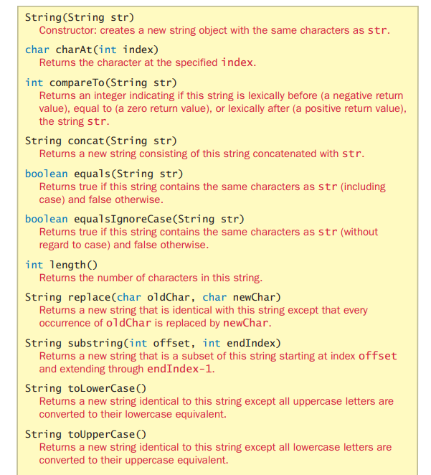

Slide 24
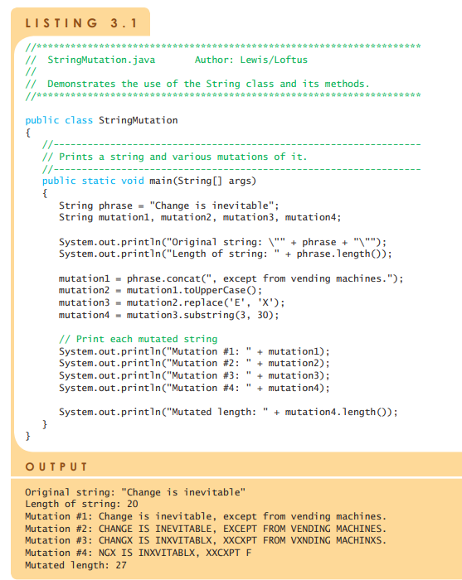


Slide 25
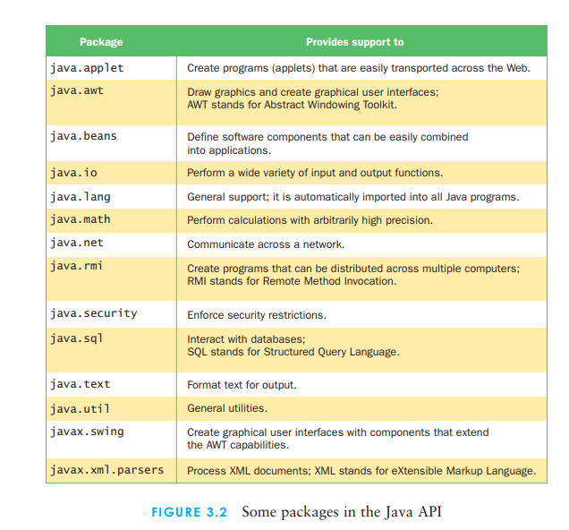

Slide 26
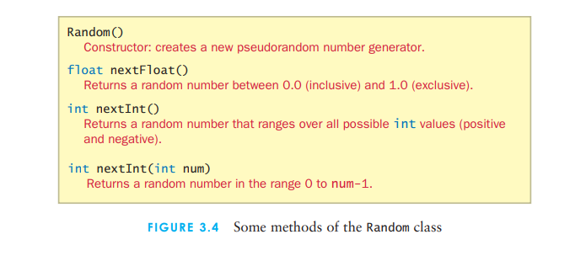


Slide 27
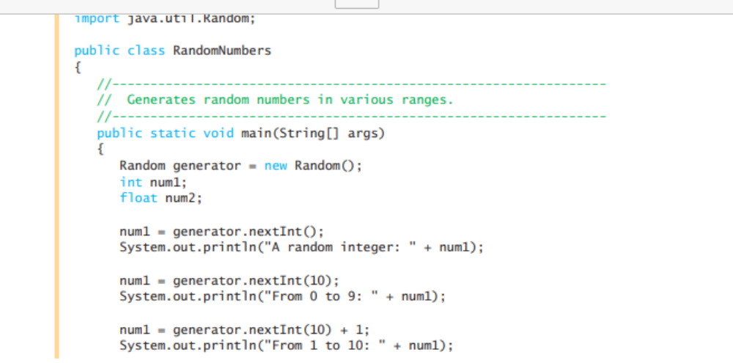
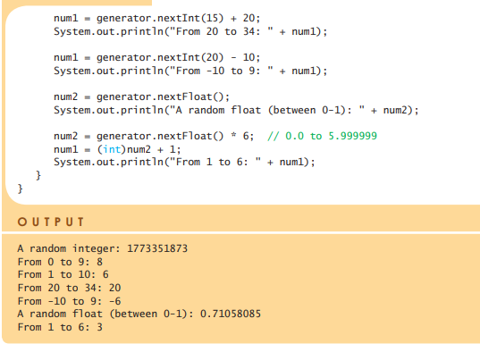

Slide 28
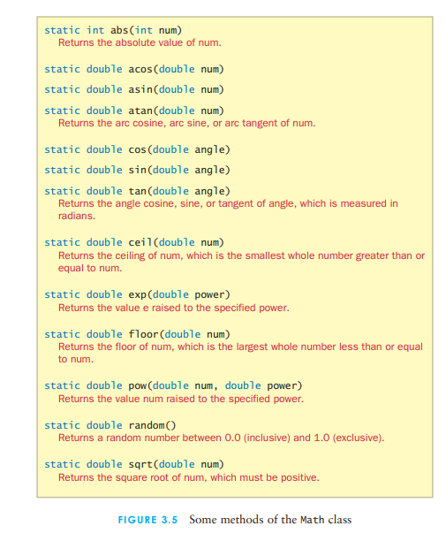

Slide 29
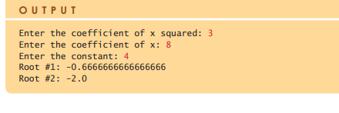
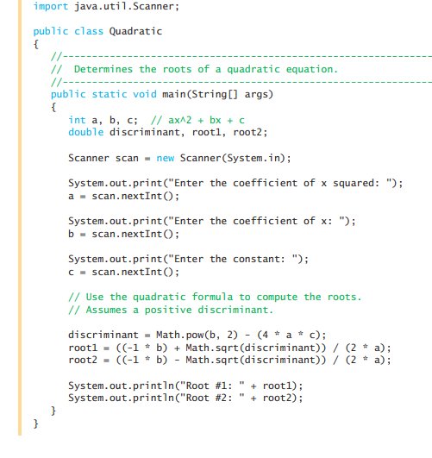


Slide 30
Summary
Classes, objects, and methods are the basic components used in Java programming.
We have discussed:
  How to define a class
  How to create objects
  How to add data fields and methods to classes
  How to access data fields and methods to classes

